Slide 1
Conversation Class
Christopher bAUMAN

Slide 2
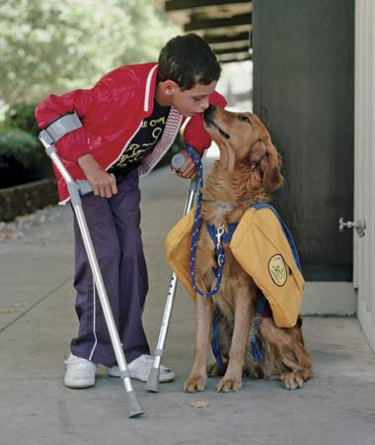
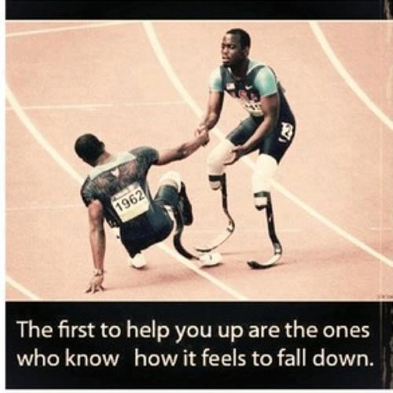
Education Infographic
Chris Bauman

